Slide 1
Stream ThousandEyes Data to Splunk Using OpenTelemetry
Antonio Jimenez – Tech Lead Software Engineer @ajimenez1503
DEVWKS-2656
Notes:
Welcome to my session.
I would like to start with a question. Have you heard about ThounsandEyes/Splunk/OpenTelemetry? You are lucky
Today, we are going to learn how to stream ThousandEyes data to Splunk using OpenTelemetry

Slide 2

Detect Outages Instantly with ThousandEyes
Notes:
Could you imagine detecting a outages from hours to minutes?
Changing from screaming customers to proactive solutions?
Our key message is to detect outages instantaneously using ThousandEyes.
That is why we are all here. Send ThousandEyes data to Splunk and detect the issues quickly.

Slide 3

Agenda
Introduction
OpenTelemetry
ThousandEyes
Splunk
Workshop
ThousandEyes
Splunk Enterprise
Splunk Observability Cloud
Notes:
Agenda
Goal
The goal of the talk is that you understand how easy is to stream ThousandEyes telemetry data to any observability backend
Time to meet the speaker:
I am Antonio Jimenez
Working on Cisco ThousandEyes during the last 2 years
Focus on Observability and OpenTelemetry during the last 4 years
In my free time I love traveling and running tech communities

Slide 4
Introduction

Slide 5
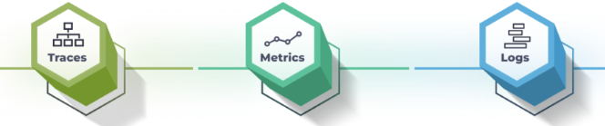
OpenTelemetry (OTel)
Open-source observability framework
Collection of tools, APIs, and SDKs
Management of telemetry data
Instrument, generate, collect, and export
Notes:
- Cloud Native Computing Foundation (CNCF) - Vendor agnostic

Slide 6

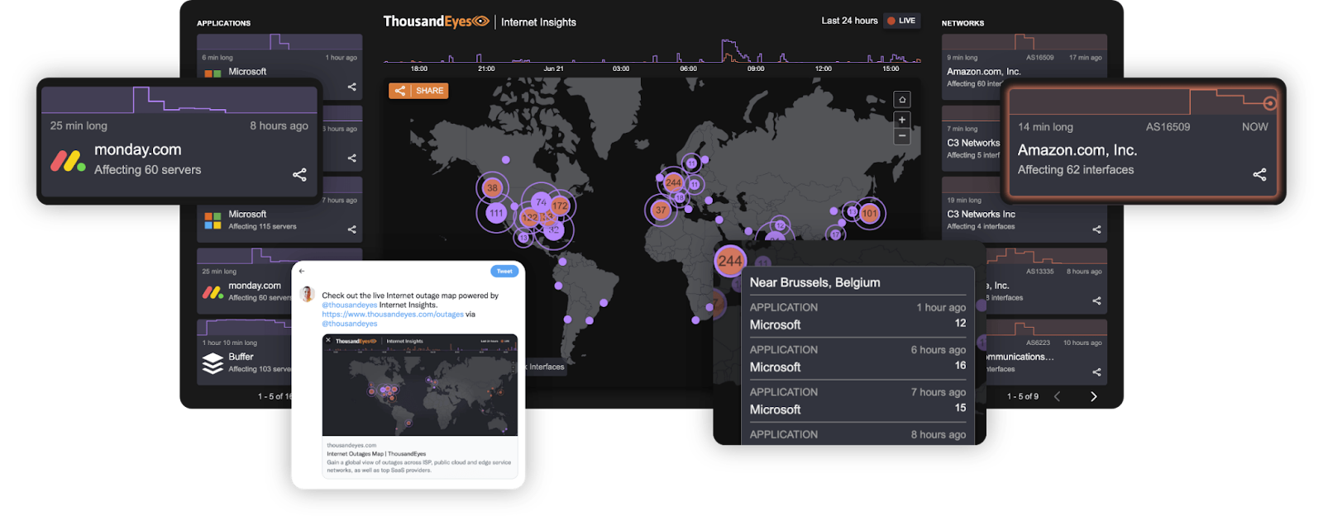
ThousandEyes
Network monitoring
Inside and outside an organization's control
Monitoring agents around the world
Real-time

Slide 7
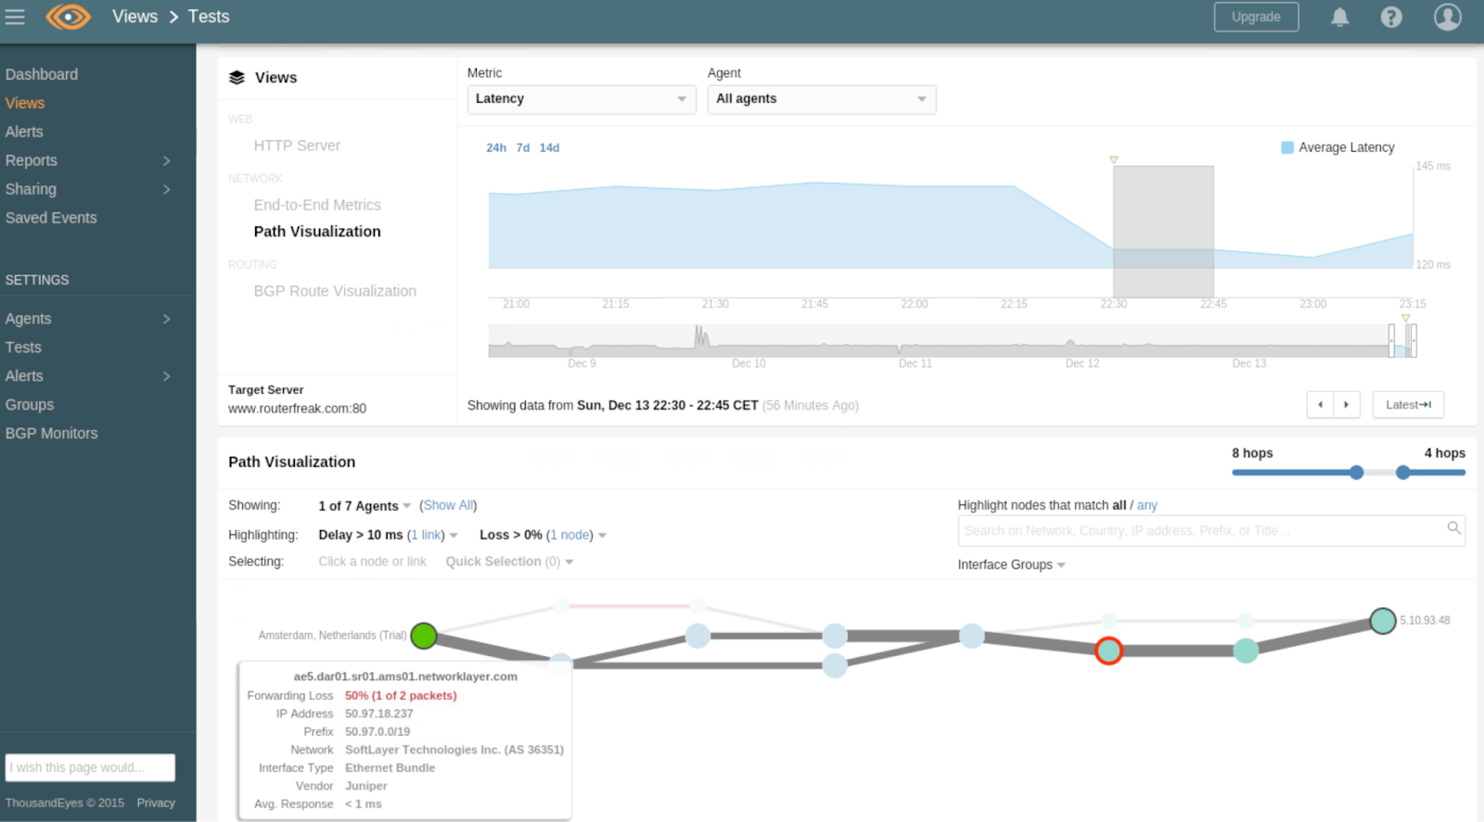
ThousandEyes Network Test
Periodically
Metrics collected: latency, page load time, throughput...
~30k data points/sec

Slide 8

Have you used Splunk before? If so, which product(s)?
Join at
slido.com
# 3469654

Slide 9

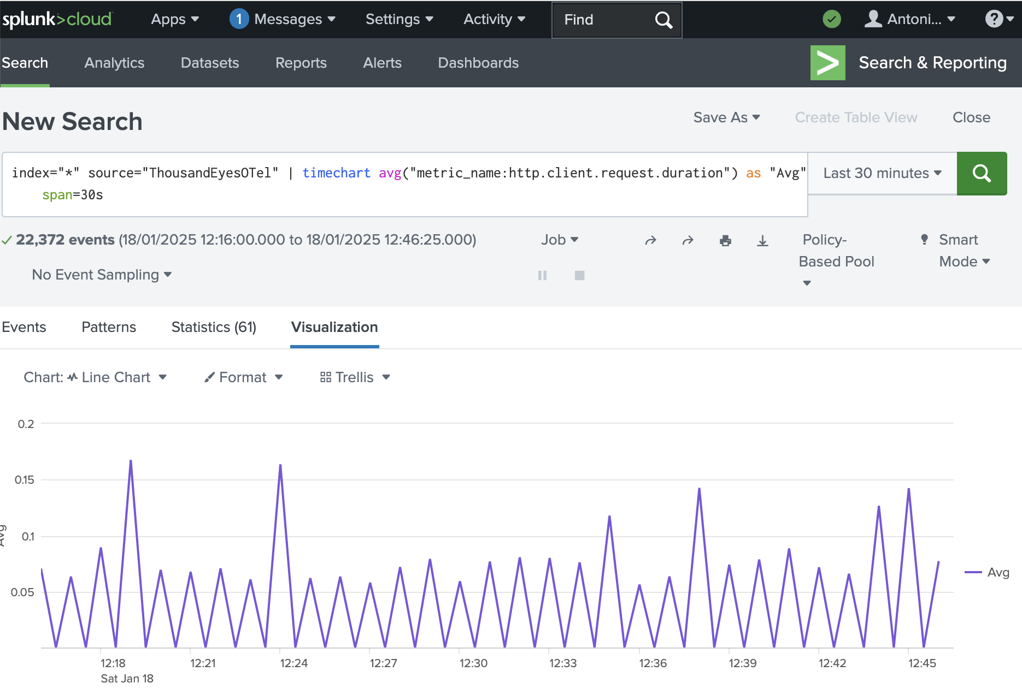
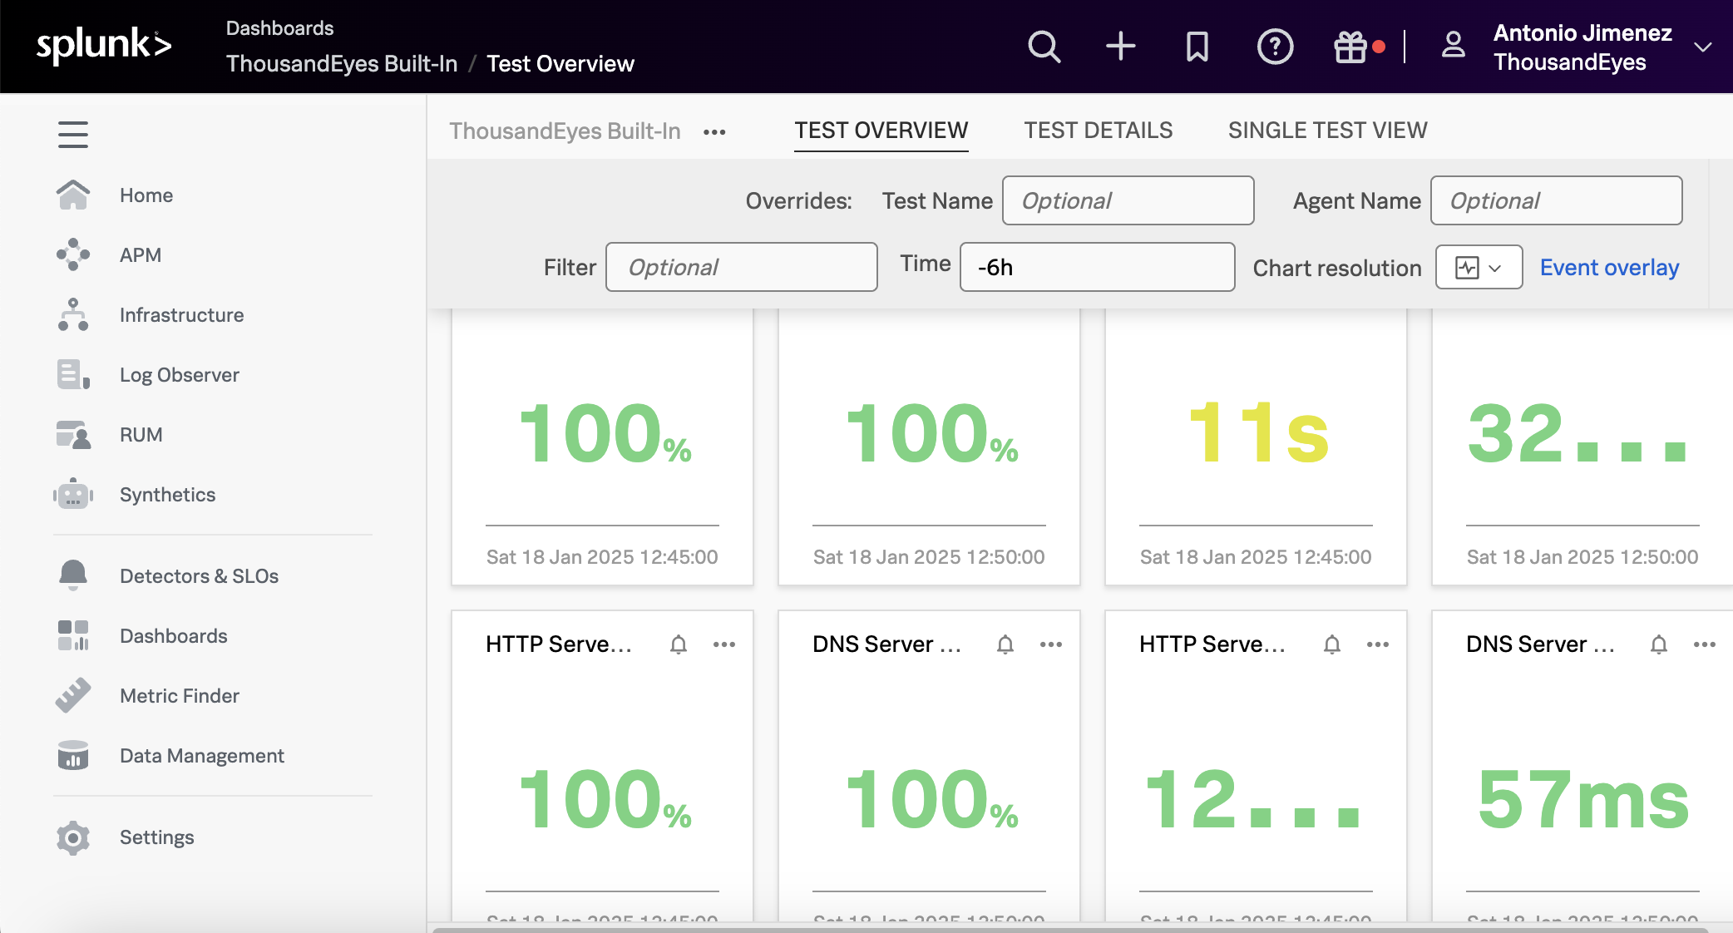
Splunk products
Splunk Enterprise & Splunk Cloud Platform
IT operations, security and business analytics
Highly customizable
Splunk Observability Cloud
Real-time application observability
APM (Application Performance Monitoring)
RUM (Real User Monitoring)

Slide 10
Workshop

Slide 11

Workshop
Splunk Enterprise
Splunk Observability Cloud

Slide 12
Login – User & Password
Email
antonjim+devnet.ws2.<seat>@cisco.com
e.g. antonjim+devnet.ws2.seat1@cisco.com
Password:
C1sco12345!

Slide 13
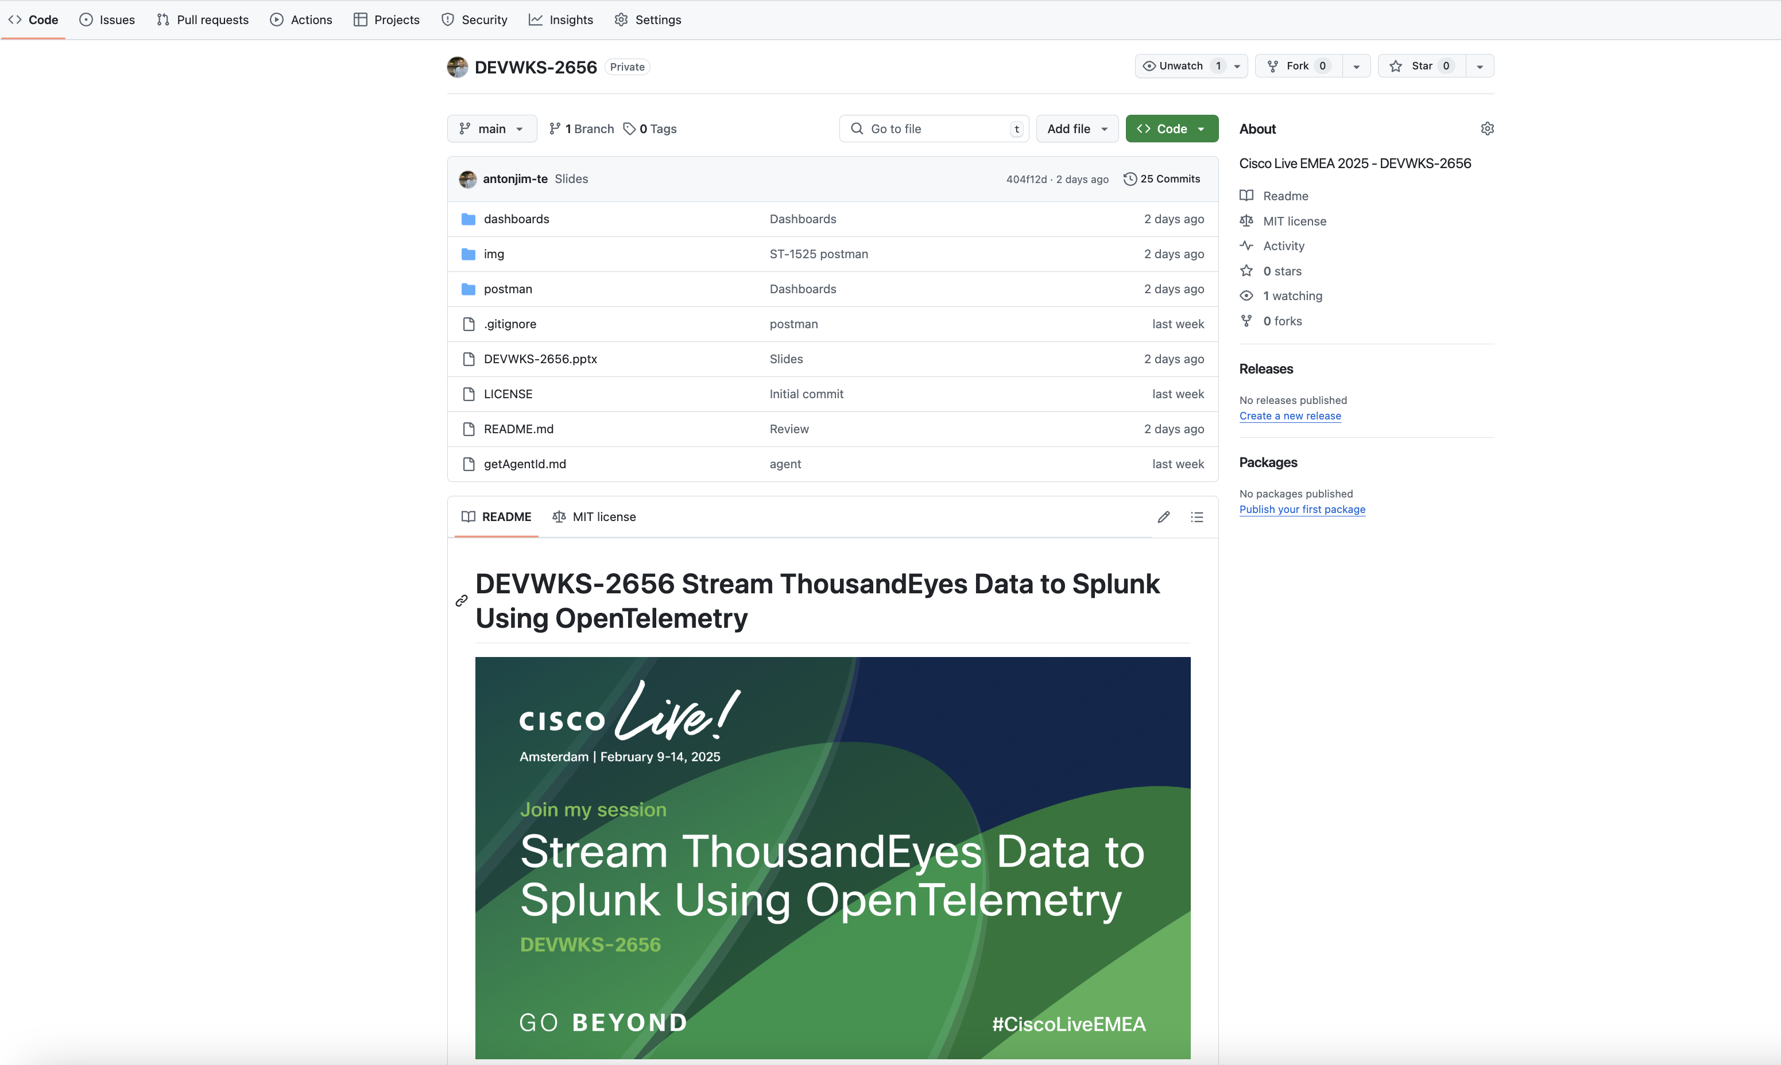

Slide 14
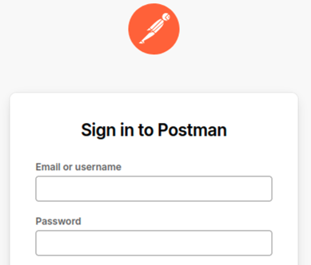
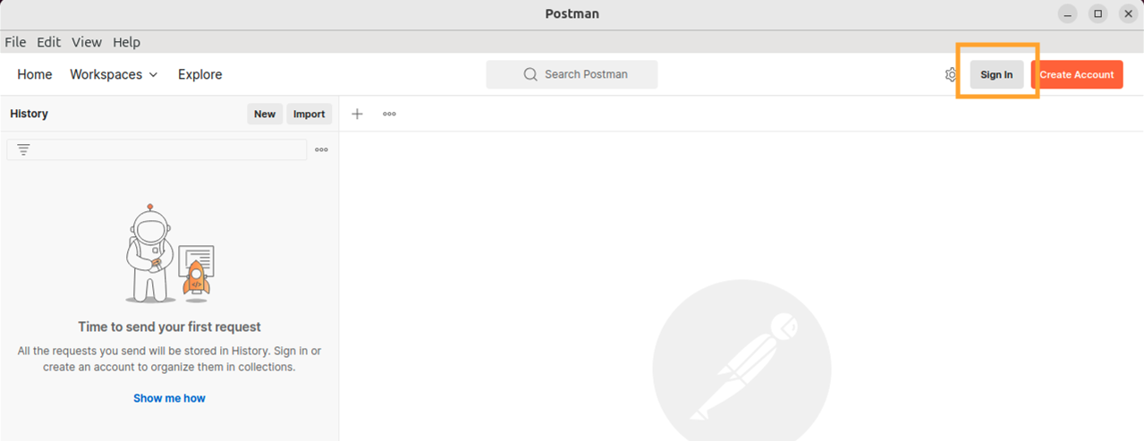
Step 1.a. Login Postman
Sign in Postman application
Email
antonjim+devnet.ws2.<seat>@cisco.com
e.g. antonjim+devnet.ws2.seat1@cisco.com
Password:
C1sco12345!

Slide 15
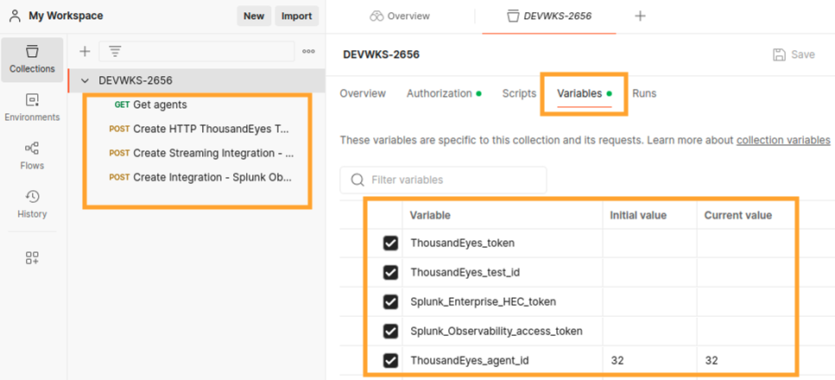
Step 1.b. Verify Postman collection DEVWKS-2656
Notes:
Navigate to Workspaces -> My Workspace
Identify the collection DEVWKS-2656Confirm the requests and variables are there.
We will use them during the session.

Slide 16
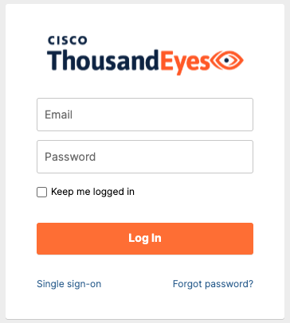
Step 2. Login ThousandEyes
Navigate to ThousandEyes Login
Email
antonjim+devnet.ws2.<seat>@cisco.com
e.g. antonjim+devnet.ws2.seat1@cisco.com
Password:
C1sco12345!

Slide 17
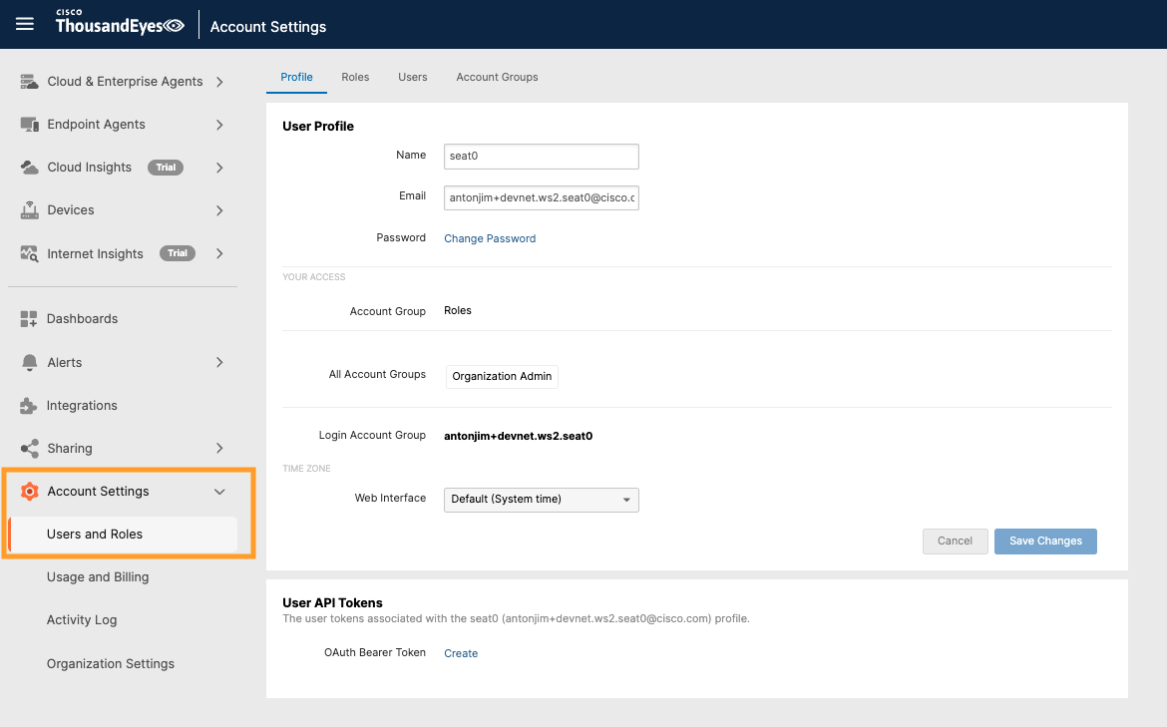
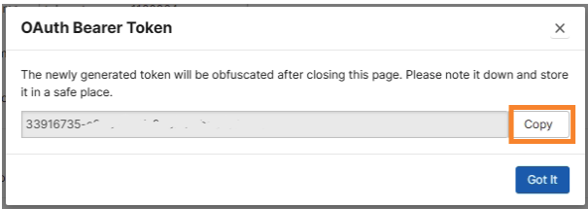
Step 3. Obtain ThousandEyes Oauth Bearer token
Navigate to Account Settings -> Users and Roles
Notes:
- ThousandEyes will generate new OAuth Bearer Token for you and show it in a new popup window

Slide 18
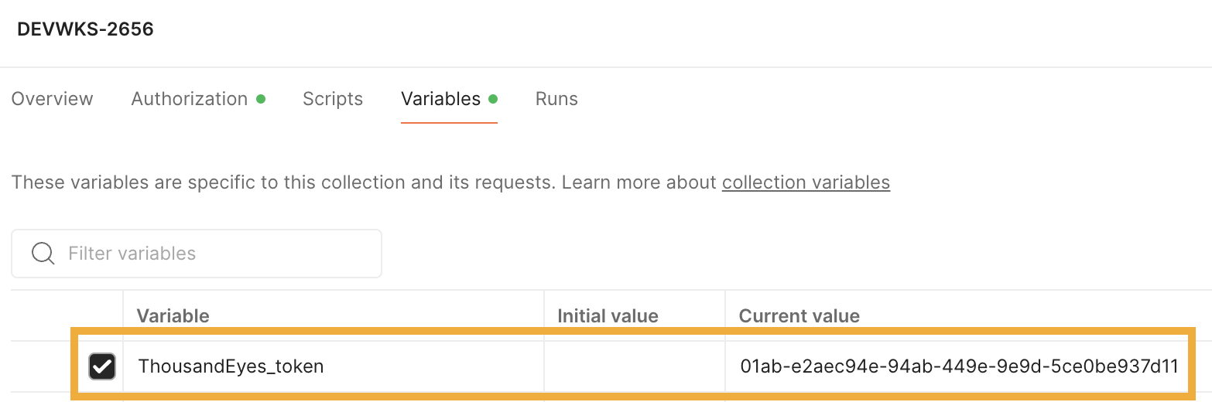
Step 3. Obtain ThousandEyes OAuth Bearer token
Save the token into the variable ThousandEyes_token in Postman

Slide 19
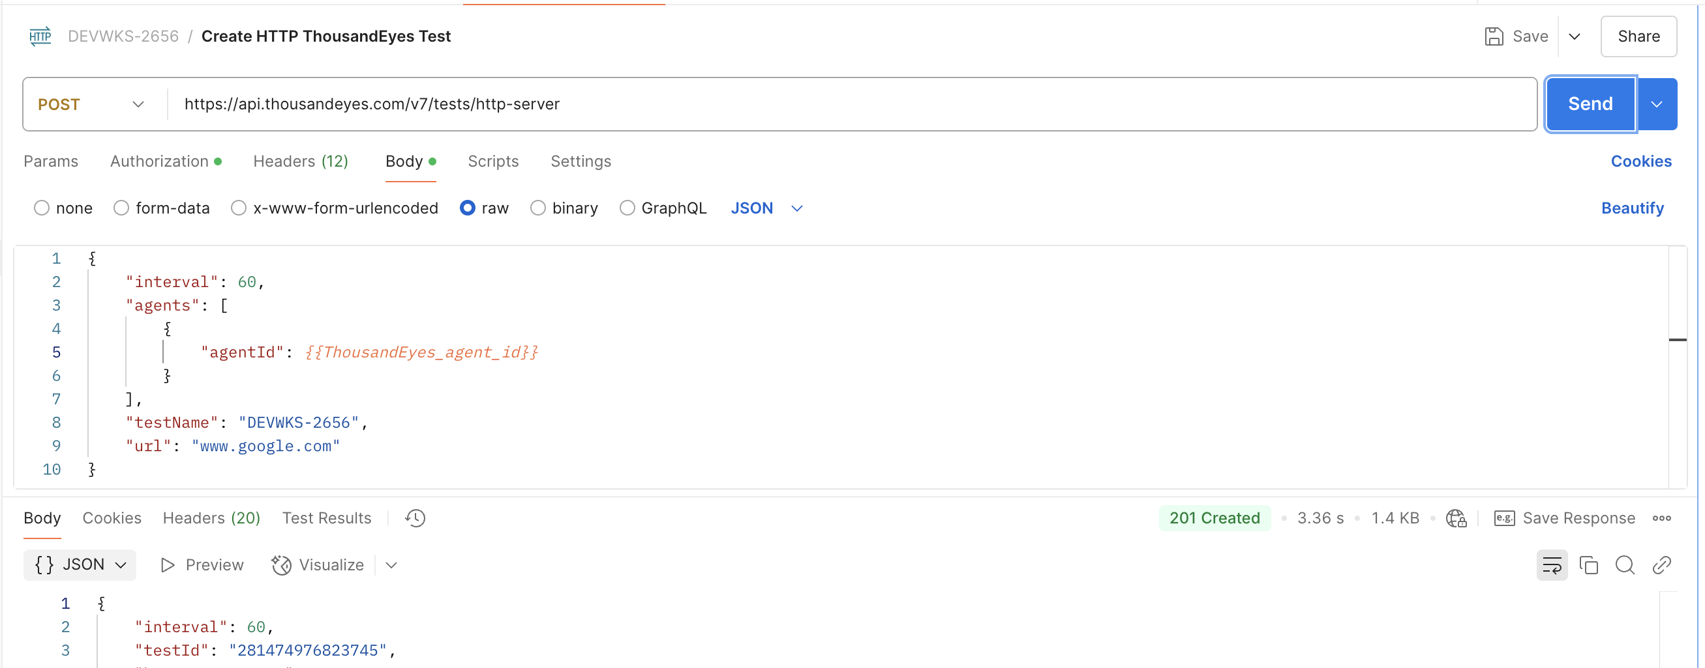
Step 4. Create ThousandEyes HTTP Server test
Notes:
Create an HTTP Server test that validates www.google.com

Slide 20
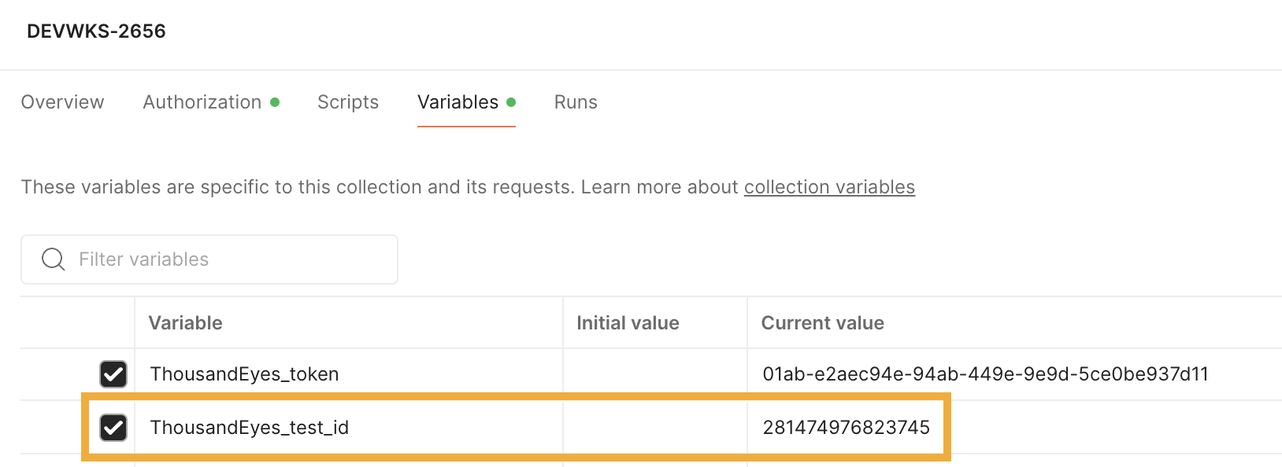
Step 4. Create ThousandEyes HTTP Server test
Save the testId into the variable ThousandEyes_test_id in Postman

Slide 21
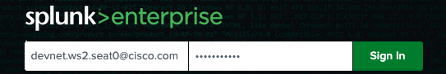
Step 5.a. Login into Splunk Enterprise
Navigate to Splunk Enterprise
Email
antonjim+devnet.ws2.<seat>@cisco.com
e.g. antonjim+devnet.ws2.seat1@cisco.com
Password:
C1sco12345!

Slide 22
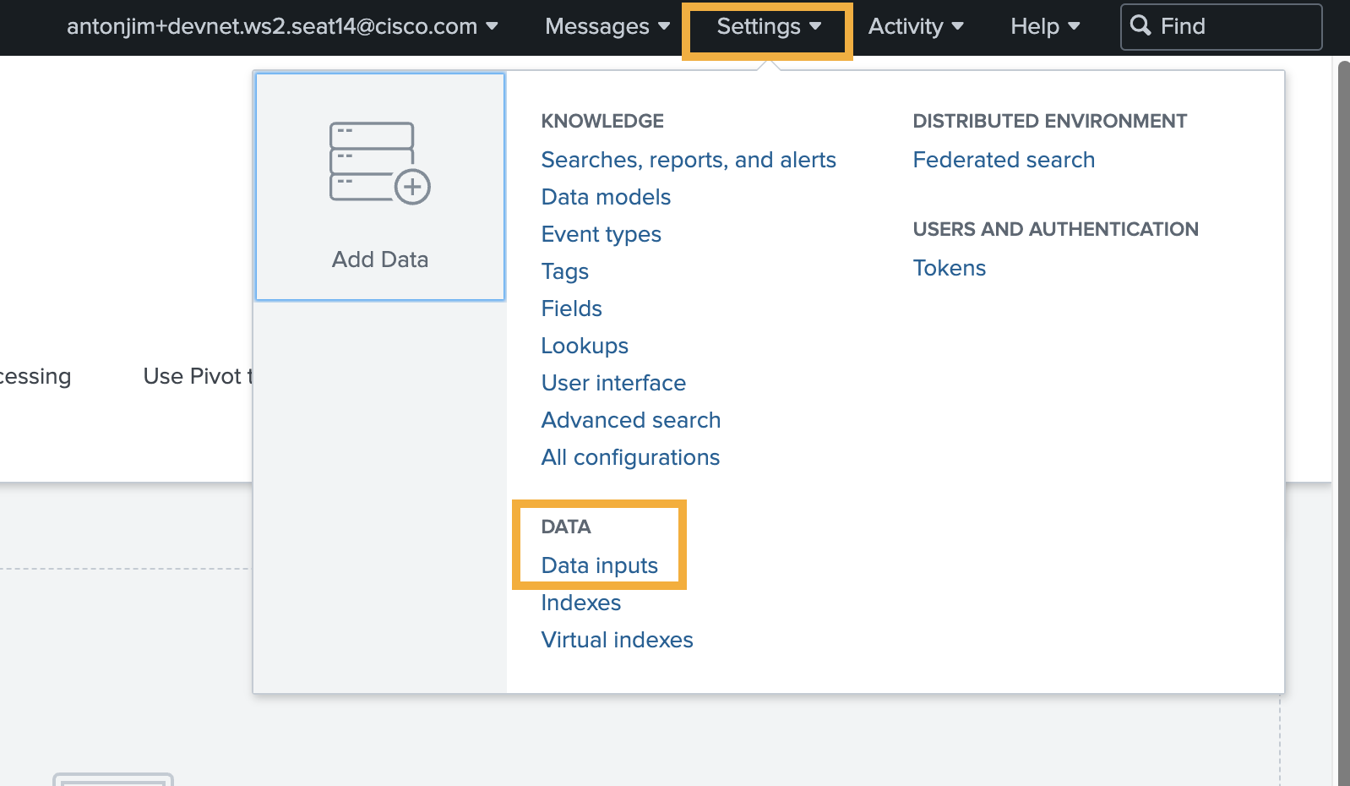
Step 5.b. Get Splunk HEC token
Navigate to Settings -> Data Inputs

Slide 23
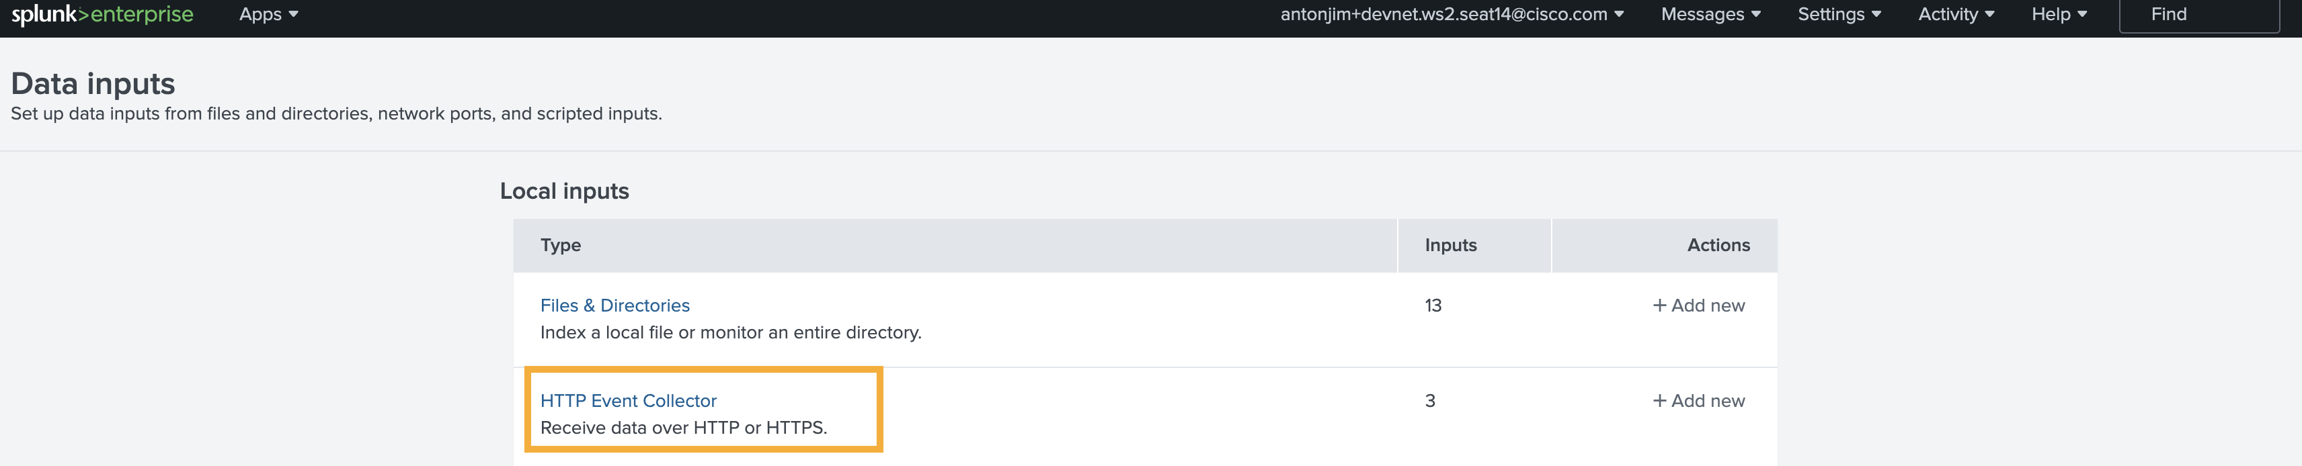
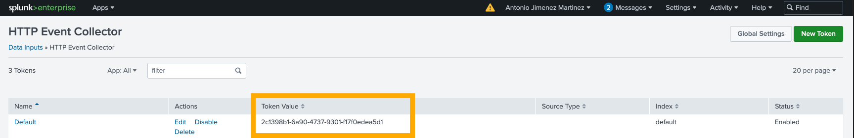
Step 5.b. Get Splunk HEC token
Open HTTP Event Collector
Copy the token from Default

Slide 24
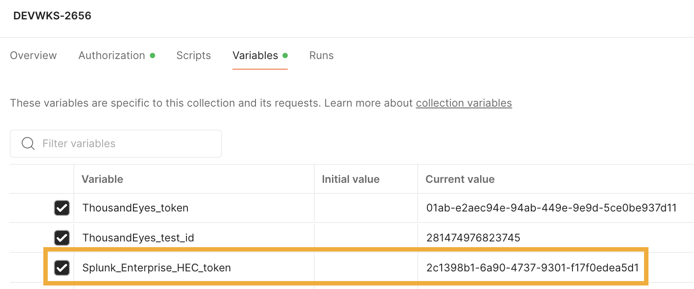
Step 5.b. Get Splunk HEC token
Save the HEC token into the variable Splunk_Enterprise_HEC_token in Postman

Slide 25
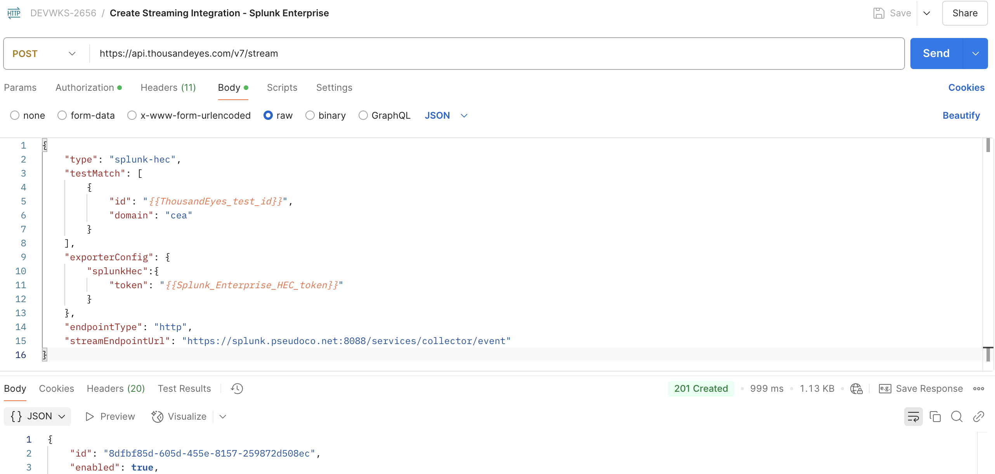
Step 5.c. Create integration for Splunk Enterprise

Slide 26
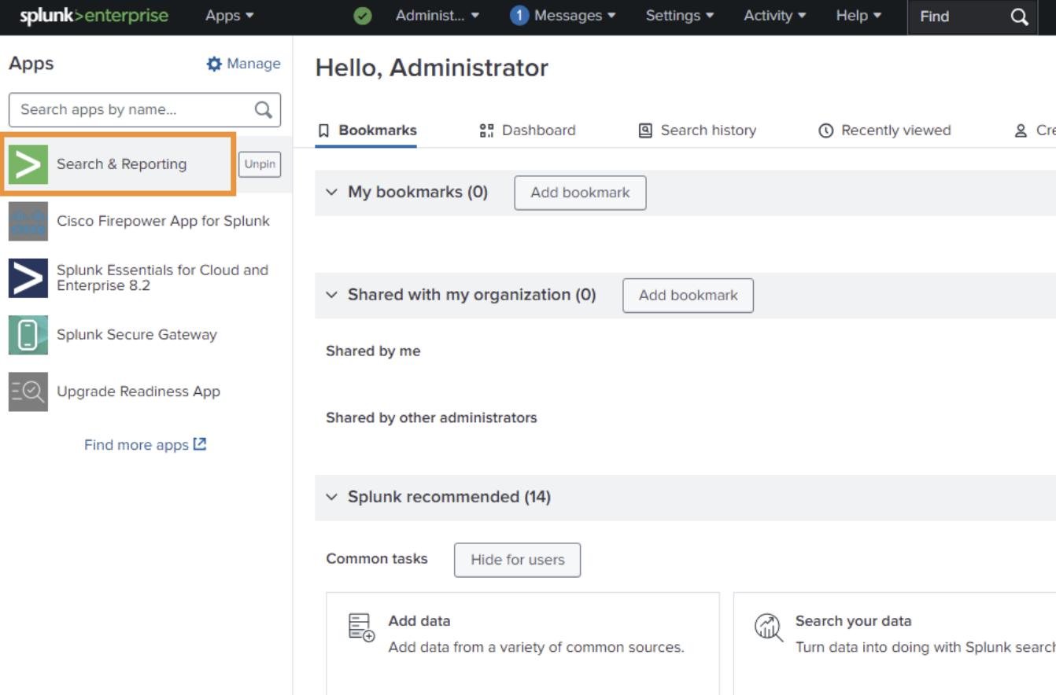
Step 6. Visualize data in Splunk Enterprise
In the initial page
Navigate to Search & Reporting

Slide 27
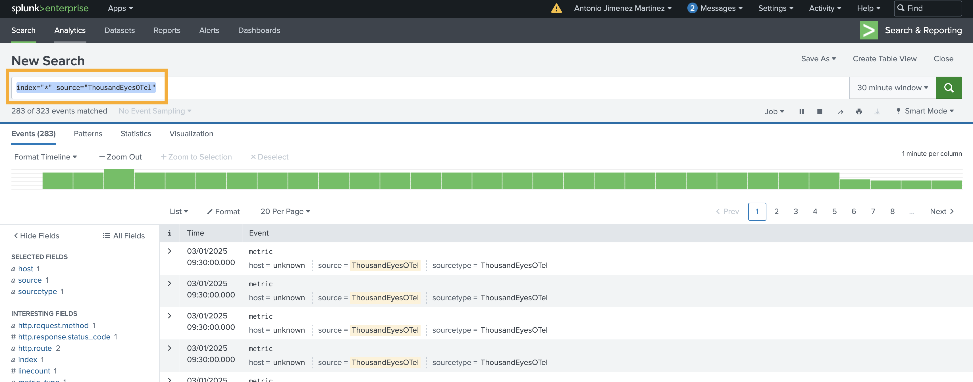
Step 6. Visualize data in Splunk Enterprise
Search by index="*" source="ThousandEyesOTel"

Slide 28
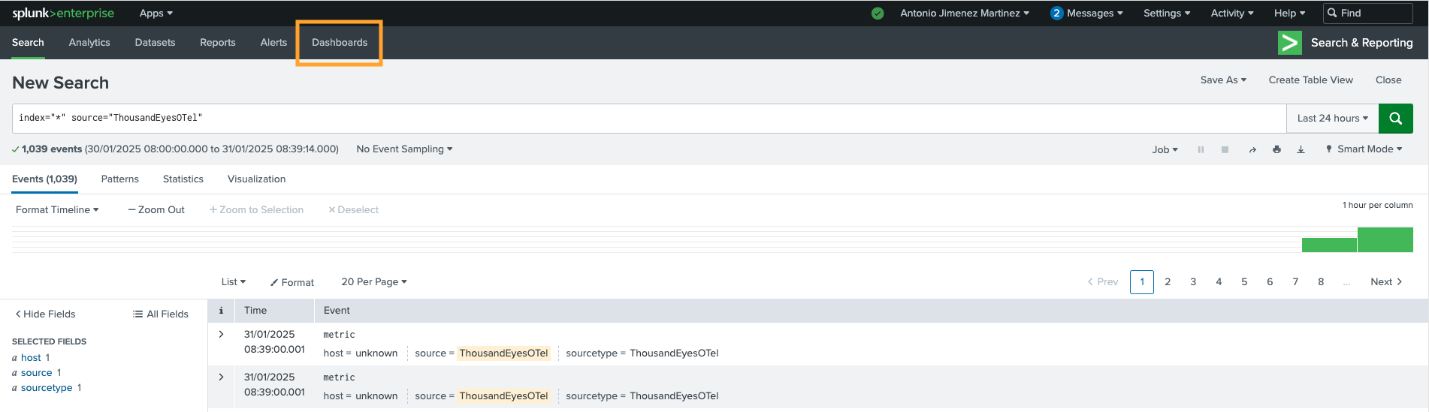
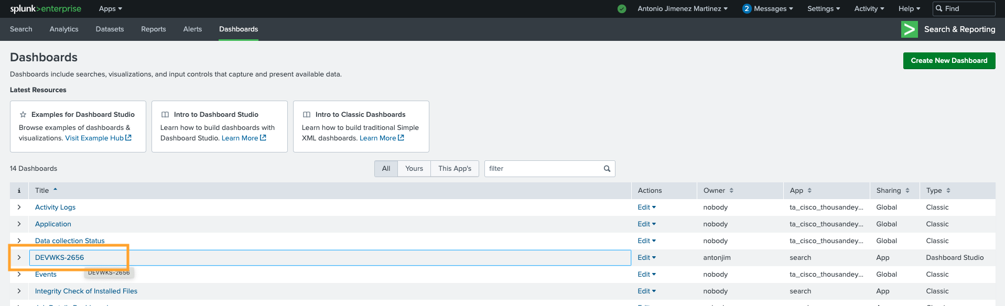
Step 6. Splunk Enterprise Dashboard
Navigate to Dashboards
Select DEVWKS-2656

Slide 29
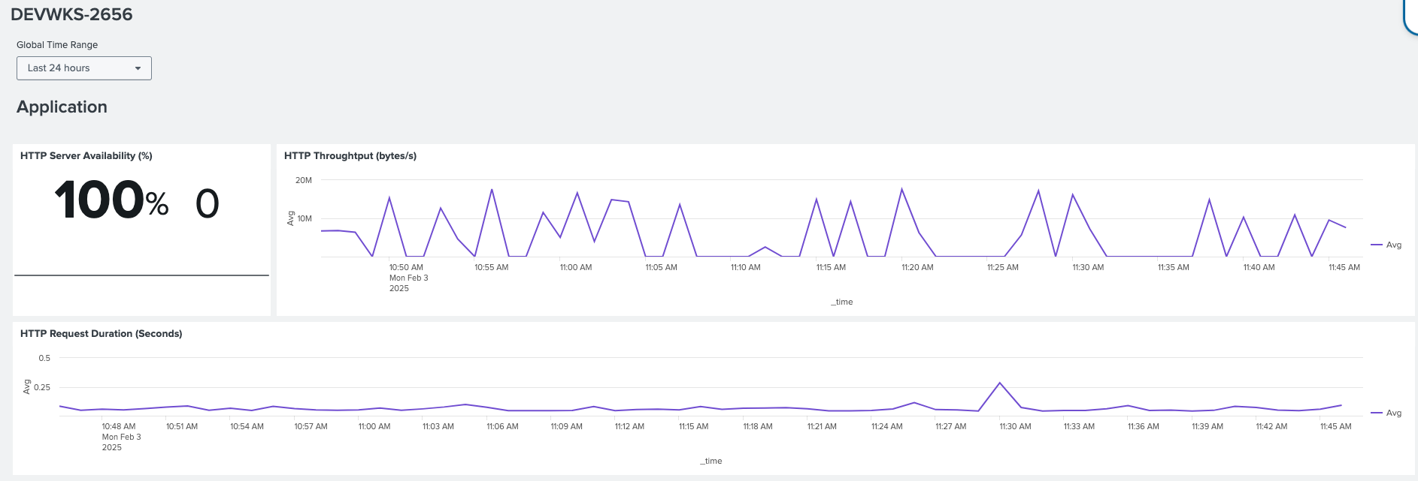
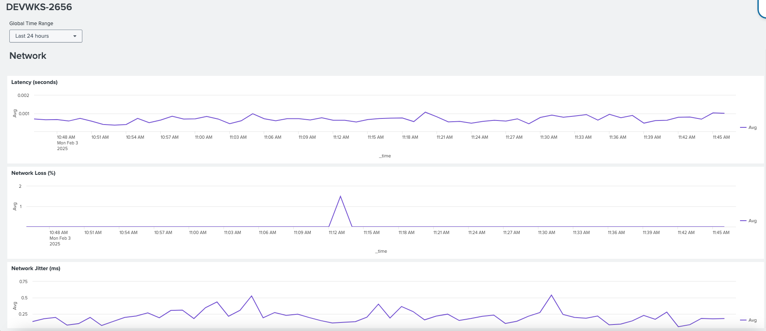
Step 6. Splunk Enterprise Dashboard

Slide 30
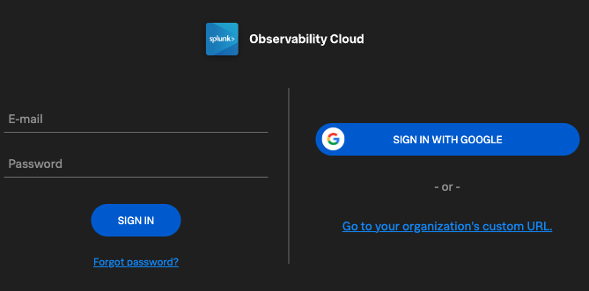
Step 7.a. Login into Splunk Observability Cloud
Navigate to Splunk Observability Cloud
Email
antonjim+devnet.ws2.<seat>@cisco.com
e.g. antonjim+devnet.ws2.seat1@cisco.com
Password:
C1sco12345!

Slide 31
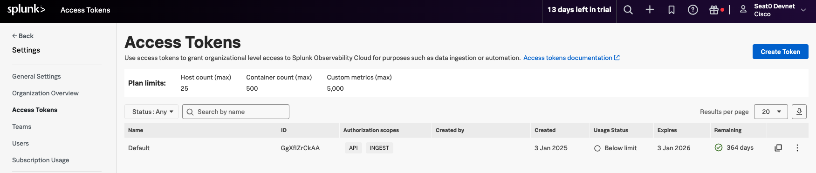
Step 7.b. Get Splunk Observability Cloud
Access Tokens
Navigate to Settings -> Access Tokens
Copy ”Default” Access Tokens

Slide 32
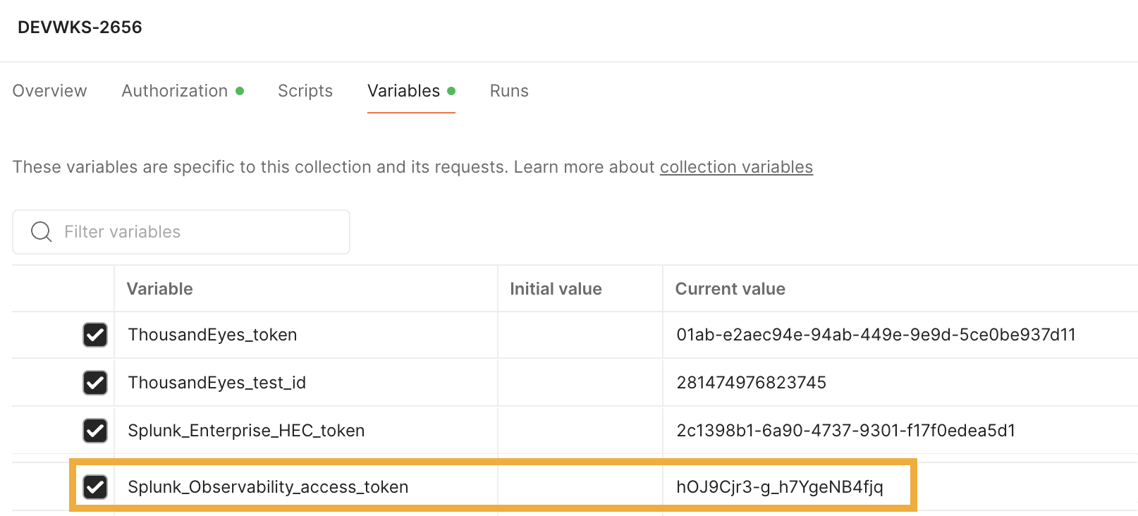
Step 7.b. Get Splunk Observability Cloud
Access Tokens
Save the token into the variable Splunk_Observability_access_token in Postman

Slide 33
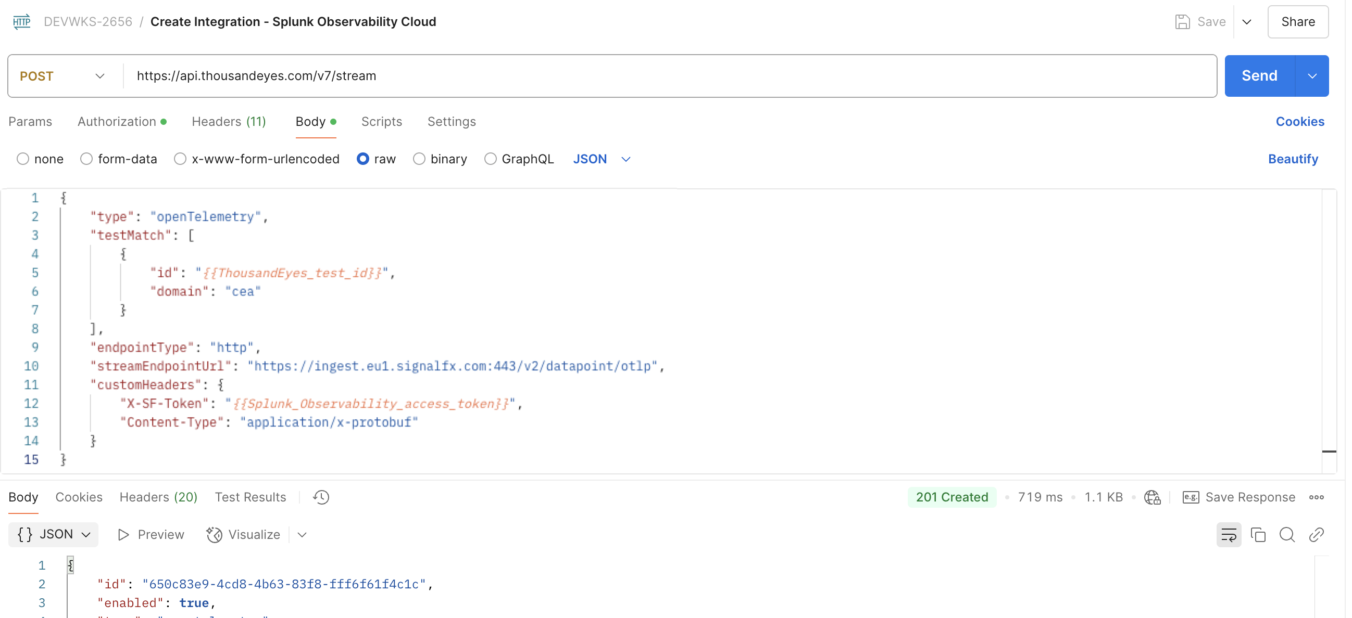
Step 7.c. Create integration for Splunk Observability

Slide 34
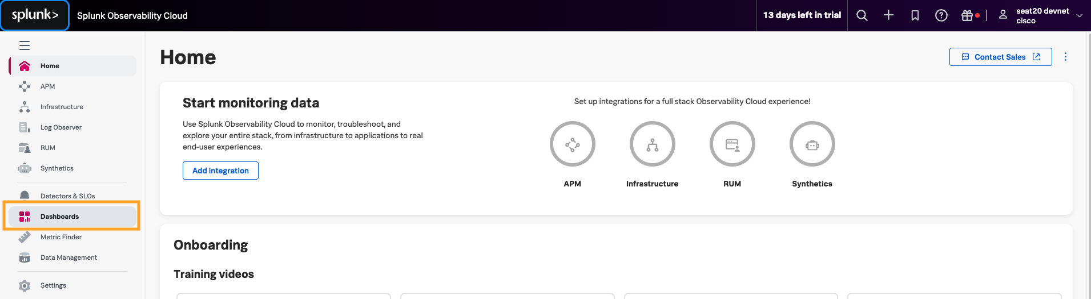
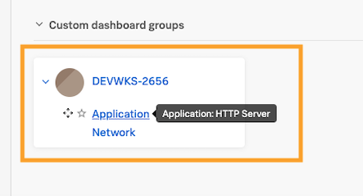
Step 8. Visualize data in Splunk Observability cloud
In the initial page
Navigate to Dashboards
Expand DEVWKS-2656
Select Application

Slide 35
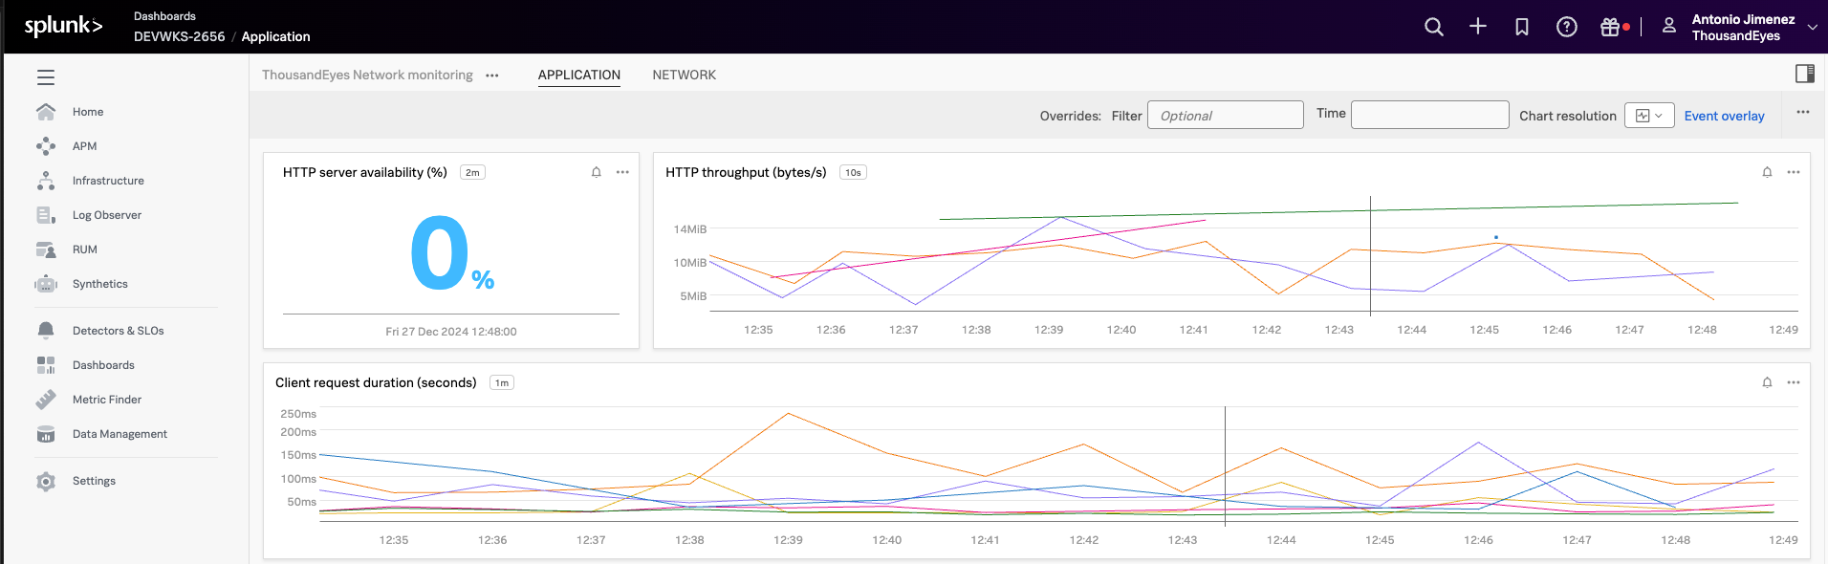
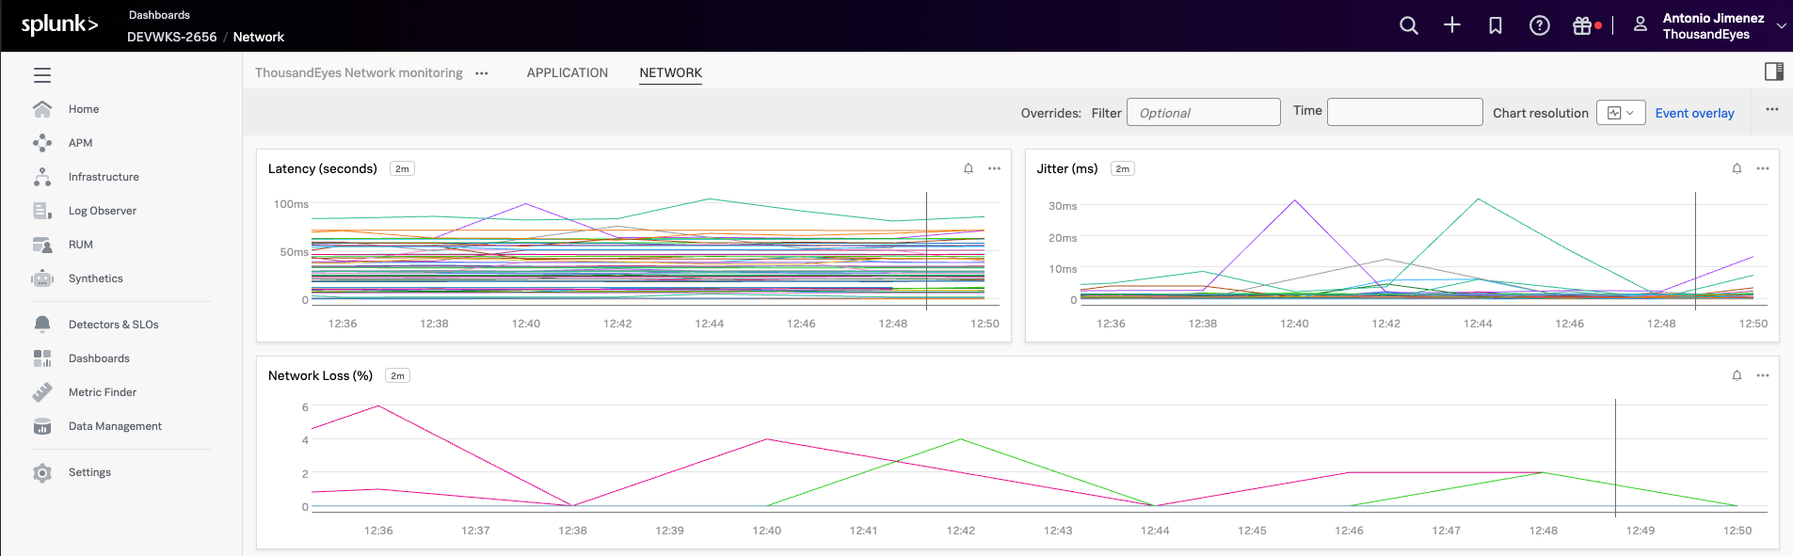
Step 8. Visualize data in Splunk Observability cloud

Slide 36
Recap
We have learned to stream ThousandEyes network telemetry data using OpenTelemetry
Confirm capability to stream to Splunk Observability Cloud and Splunk Enterprise
Main goal: Detect outages​ instantly with​ ThousandEyes

Slide 37
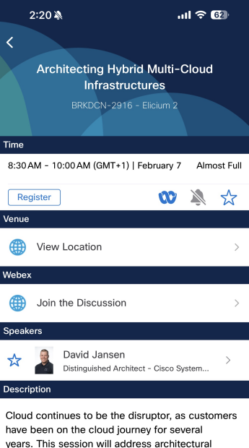

Slide 39
DEVNET-2658: Stream ThousandEyes Data to Any Observability Platform using OpenTelemetry
Visit the Cisco Showcase for related demos
Book your one-on-one Meet the Engineer meeting
Attend the interactive education with DevNet, Capture the Flag, and Walk-in Labs
Contact me at: antonjim@cisco.com

Slide 40
Questions?

